Slide 1
Problem 1
UDP and TCP use 1s complement for their checksums. Suppose you have the following three 8-bit bytes:
01010011, 01100110, 01110100
What is the 1s complement of the sum of these 8-bit bytes?
(Note that although UDP and TCP use 16-bit words in computing the checksum, for this problem you are being asked to consider 8-bit sums.) Show all work.
Why is it that UDP takes the 1s complement of the sum; that is, why not just use the sum?
With the 1s complement scheme, how does the receiver detect errors?
Is it possible that a 1-bit error will go undetected?
How about a 2-bit error?

Slide 2
Solution 1
01010011 (1. byte)
+ 01100110 (2. byte)
10111001
+ 01110100 (3. byte)
00101101
+ 11010010 (1s complement) <- checksum
11111111

Slide 3
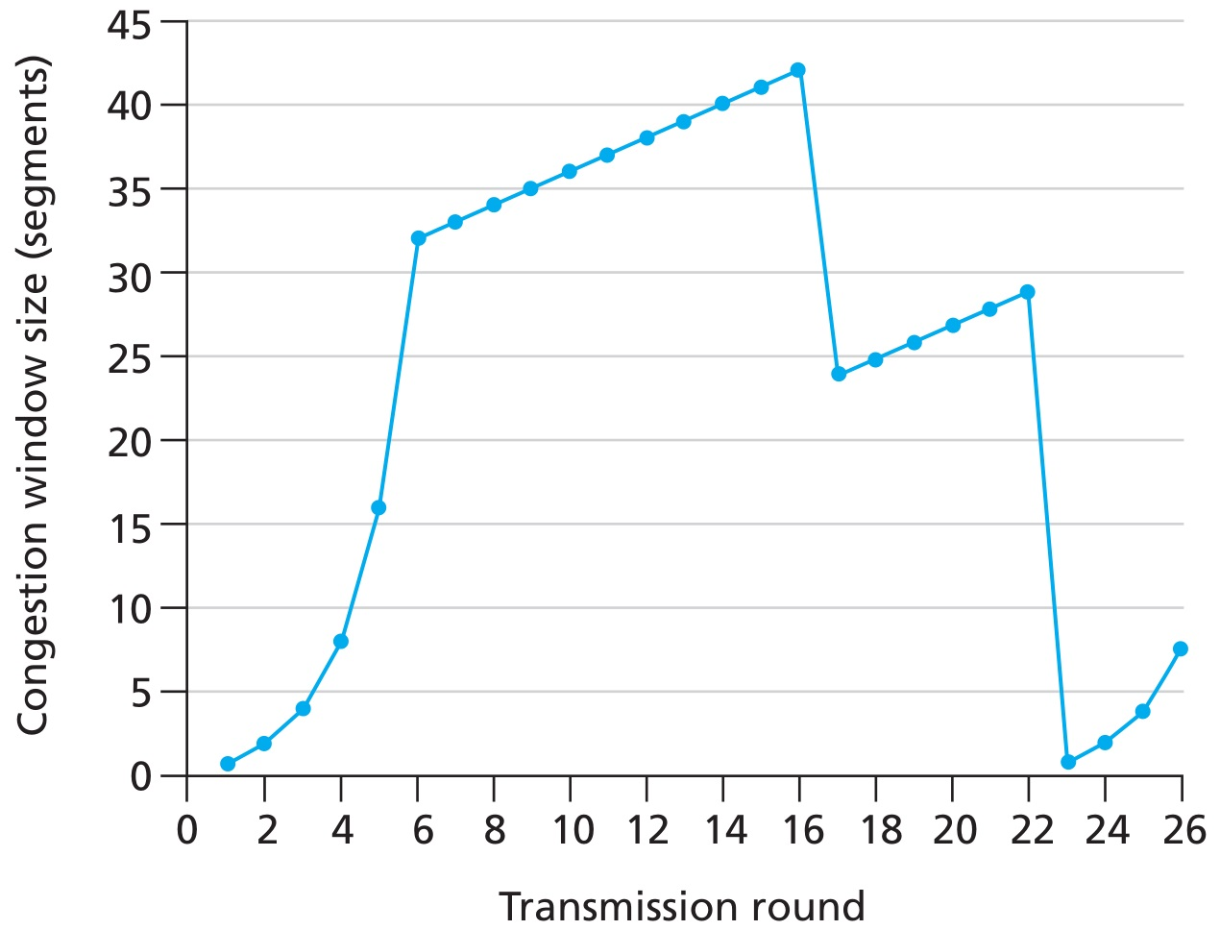
Problem 2
Intervals of time when TCP slow start is operating.
Intervals of time when TCP congestion avoidance is operating.
For the 16th and 22nd transmission round is segment loss detected by a triple duplicate or by a timeout?
What is the value of ssthresh
at the first transmission round?
at the 18th transmission round?
at the 24th transmission round?
During what transmission round is the 70th segment sent?

Slide 4
Solution 2
TCP slowstart is operating in the intervals [1,6] and [23,26].
TCP congestion advoidance is operating in the intervals [6,16] and [17,22]
16th transmission round -> a triple duplicate ACK, 22nd transmission round -> timeout (congestion window size=1)
The ssthresh values are:
32 at the first transmission round. (congestion avoidance starts at 32)
21 at the 18th transmission round. (congestion window size 42 / 2)
13 at the 24th transmission round. (congestion window size 26 / 2)
During the 1st transmission round, packet 1 is sent; packet 2-3 are sent in the 2nd transmission round; packets 4-7 are sent in the 3rd transmission round; packets 8-15 are sent in the 4th transmission round; packets 15-31 are sent in the 5th transmission round; packets 32-63 are sent in the 6th transmission round; packets 64 – 96 are sent in the 7th transmission round. Thus packet 70 is sent in the 7 th transmission round.

Slide 5
Problem 2
Assuming a packet loss is detected after the 26th round by the receipt of a triple duplicate ACK, what will be the values of the congestion window size and of ssthresh?
Suppose TCP Tahoe is used (instead of TCP Reno), and assume that triple duplicate ACKs are received at the 16th round. What are the ssthresh and the congestion window size at the 19th round?
Again suppose TCP Tahoe is used, and there is a timeout event at 22nd round. How many packets have been sent out from 17th round till 22nd round, inclusive?

Slide 6
Solution 2
Congestion window size = 8, ssthresh = 4
ssthresh = 21, congestion window size = 4
52 packets sent

